Slide 1

GIT
A version control system
Mark turner

Slide 2
What is version control?
We’ve all been there…
Added a new feature to a program which ended up breaking a previous version
A simple example of version control:
Main.py, main-2.py, main-3.py, main-4.py, main-5.py

Slide 3
What is version control?
Main.py, main-2.py, main-3.py, main-4.py, main-5.py
However, this can become confusing, and is inefficient when each iteration may only have minor changes
More files could clog up your computer
If only there was a better way…

Slide 4
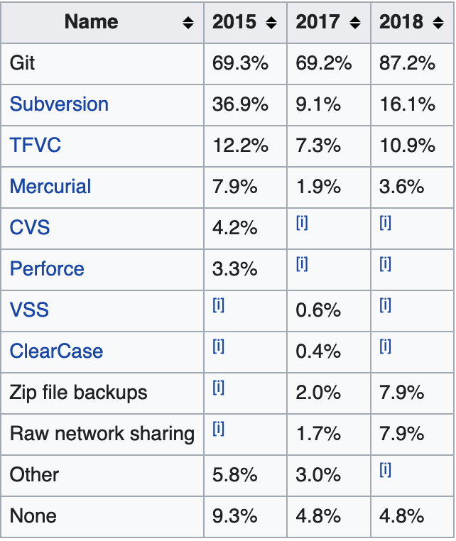
Examples of Version control systems
Git
Subversion
Zip file backups
Raw network sharing
Source: Stack Overflow Annual Developer Survey 2015, 2017, 2018

Slide 5
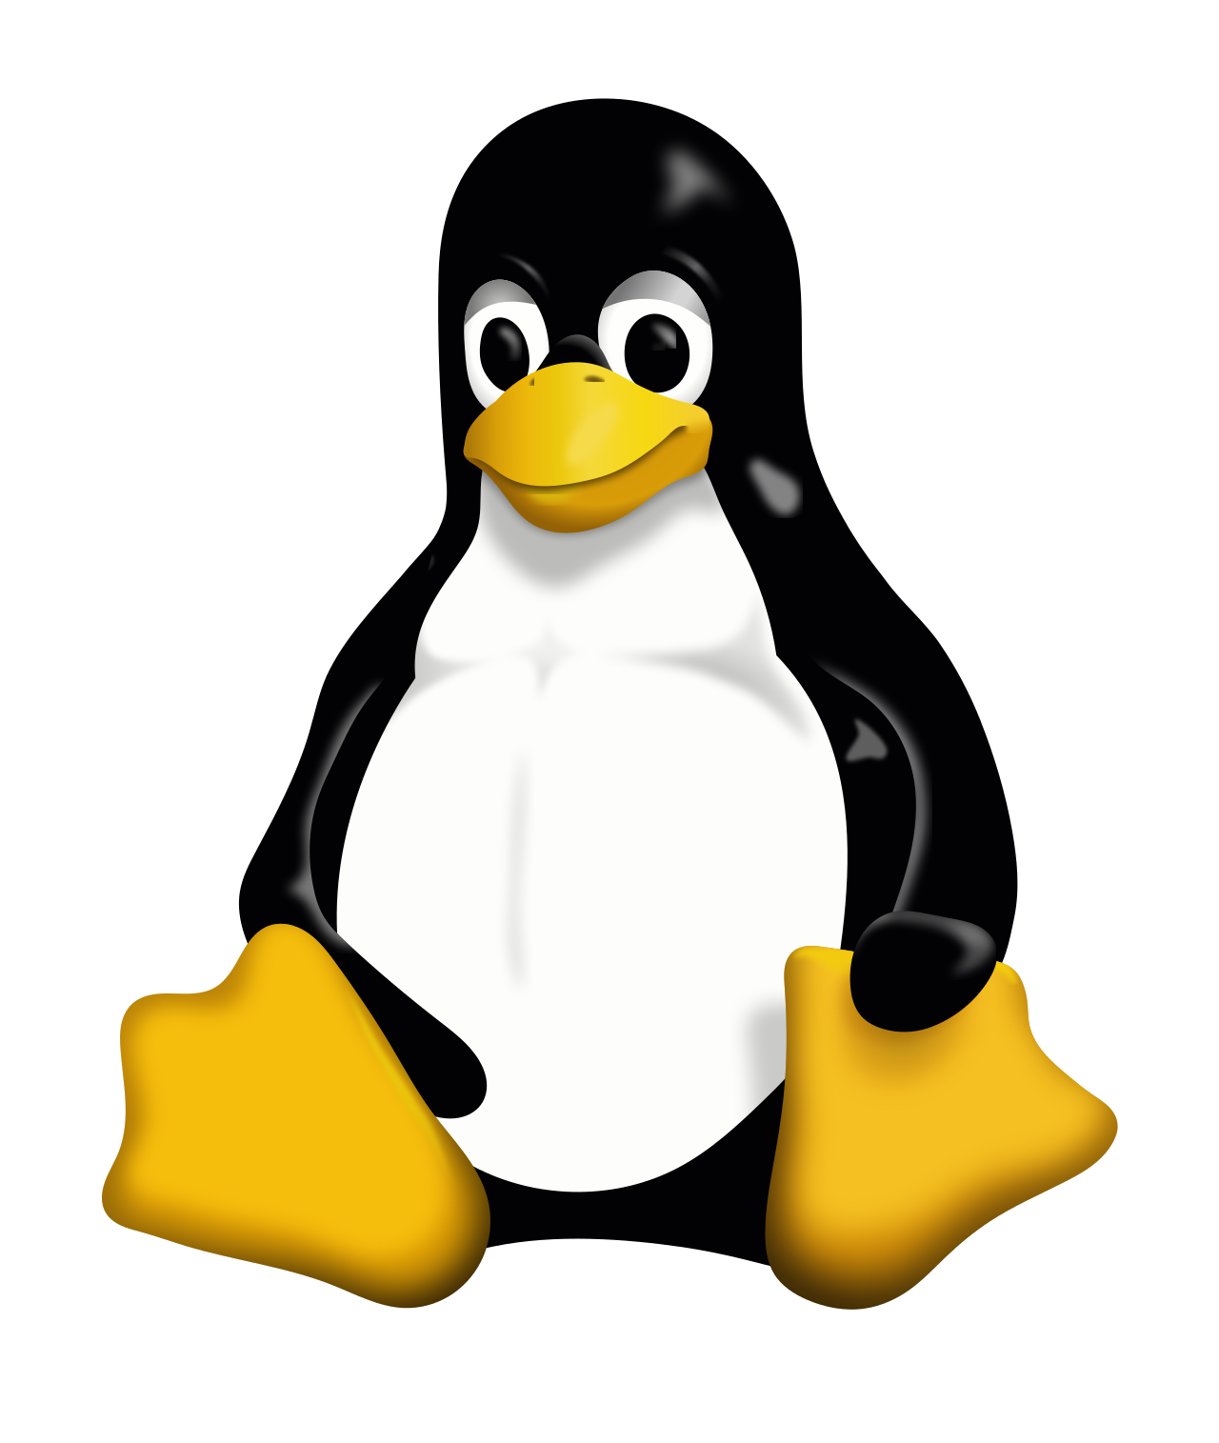
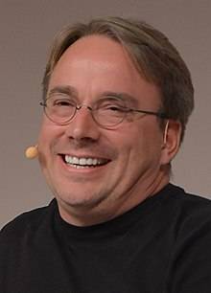
History of git
Invented by Linus Torvalds in 2005
Solving an issue where it was hard to keep track of changes on the Linux Kernel (millions of lines of code)

Slide 6
The advantages
You can go back in time!
But with the advantage of optimised storage space
You can even make branches for when you are testing features, with a master / main branch when you know something works, and then a testing branch for new features

Slide 7

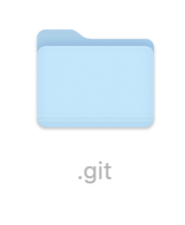
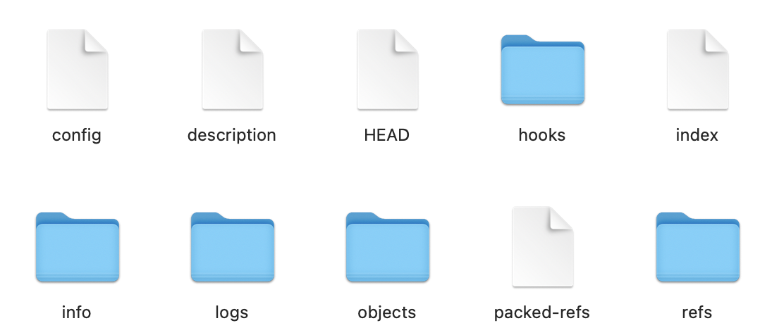
So, how does it work?
When you initialise Git, it creates a .git folder
This .git folder contains other folders and files which track the changes that are made to all the different files (objects) automatically

Slide 8
Git commit
Git won’t automatically track every single time you edit a file.
First you have to “stage” the file, meaning that its current state is ready to be committed
A git commit is when you finally want git to save your changes

Slide 9


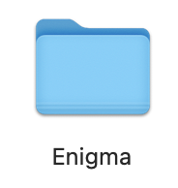


Commit
Created helpers.py
Deleted temp.txt
Staging Area
Modified main.py
Files on your computer

Slide 10
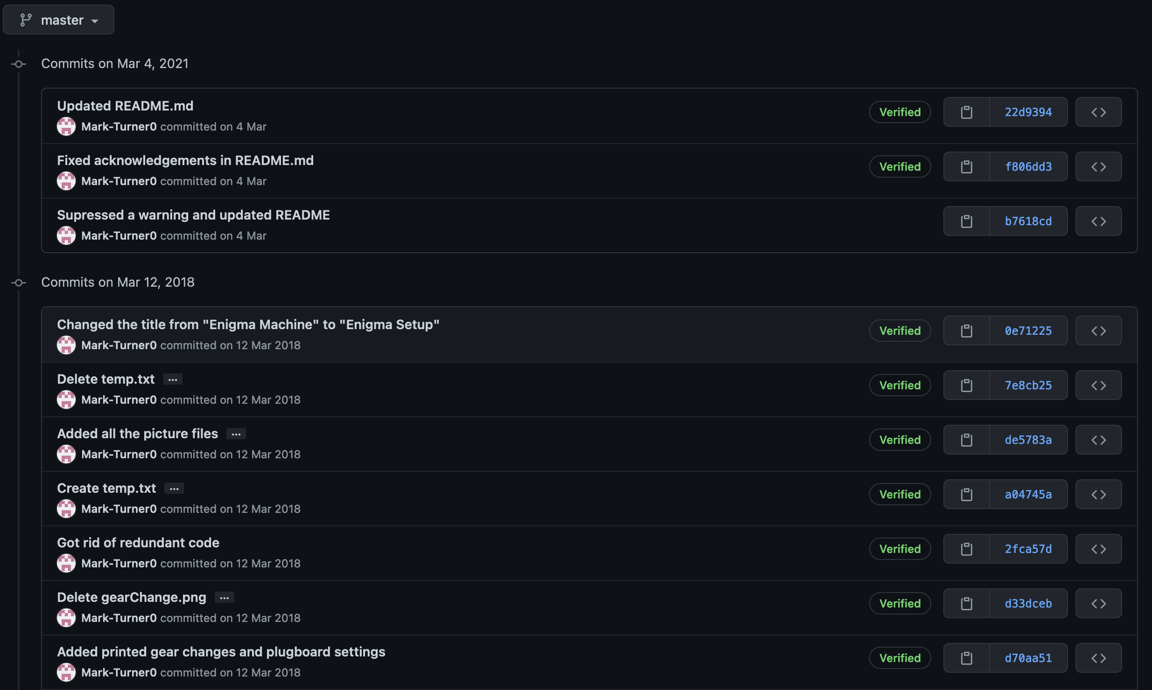
Commits can go back years!

Slide 11
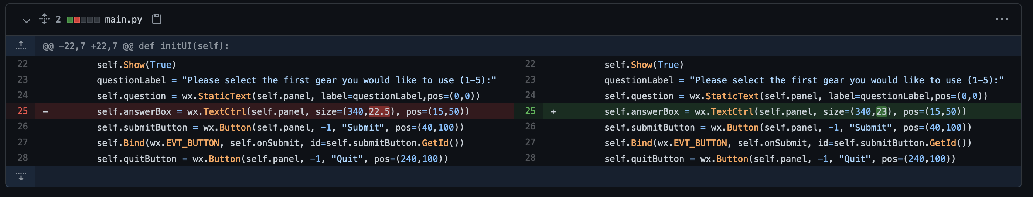
Showing the difference between commits:

Slide 12
Task: add git to one of your projects

Slide 13
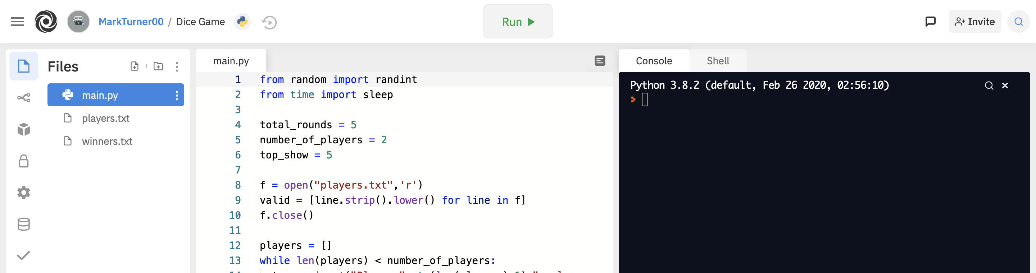
In your repl.it project…:
X

Slide 14
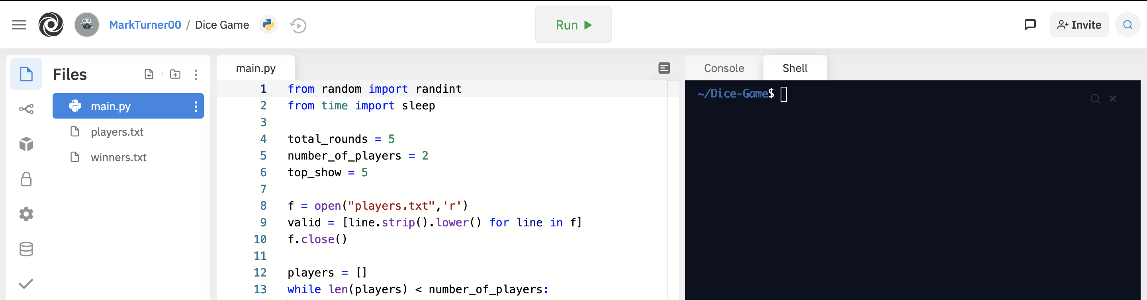
It should change to a shell

Slide 15
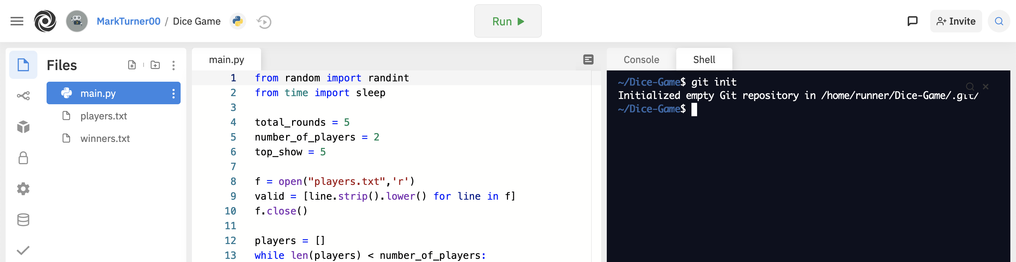
Type “git init” and hit enter
X

Slide 16
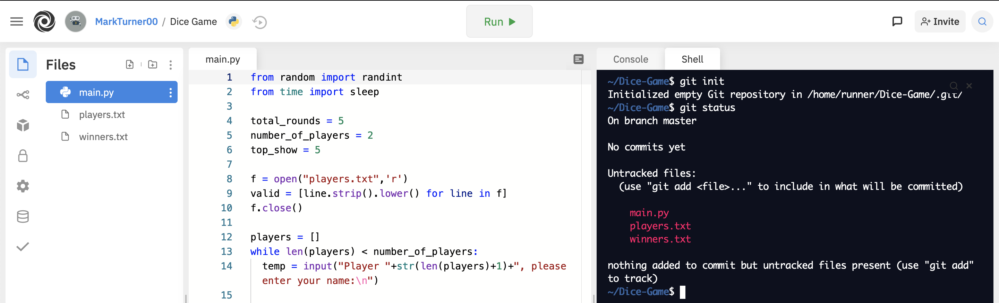
Type “git status” and hit enter

Slide 17
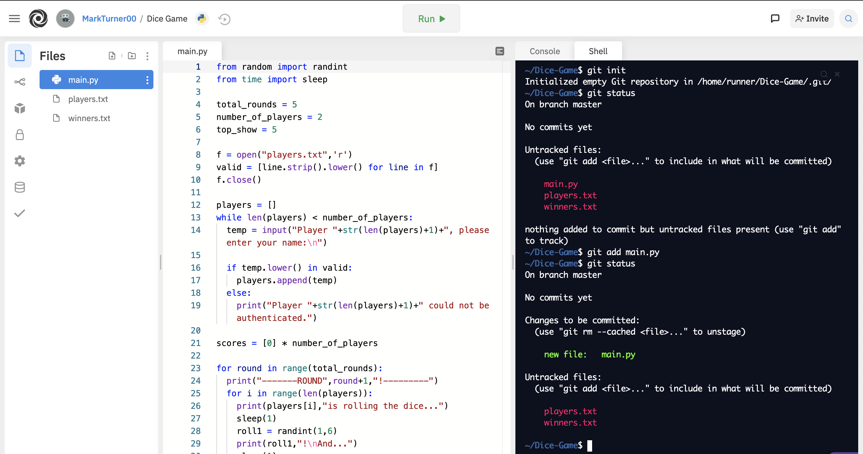
Add the files you want to track with: “git add x” where x is the filename

Slide 18
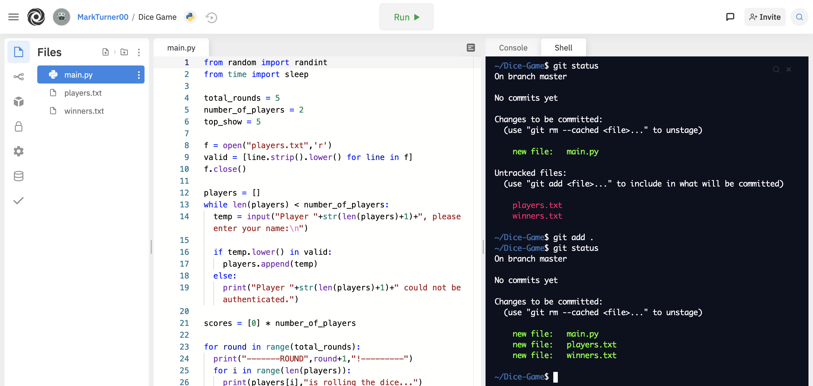
Or “git add .” to add all the files at once

Slide 19
Commit
Created helpers.py
Deleted temp.txt
Staging Area
Modified main.py
Files on your computer

Slide 20
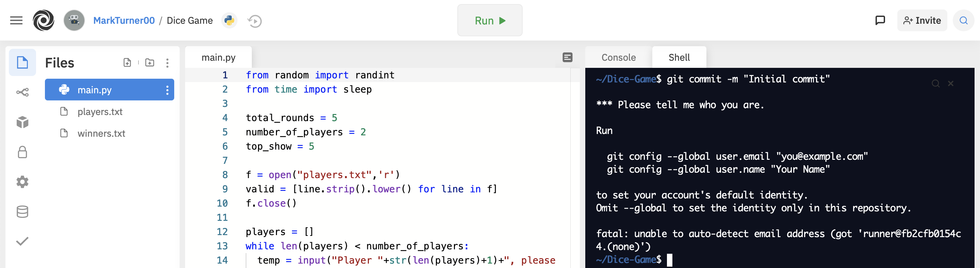
Now it’s time for our first commit! Type ”git commit –m “Initial commit”

Slide 21
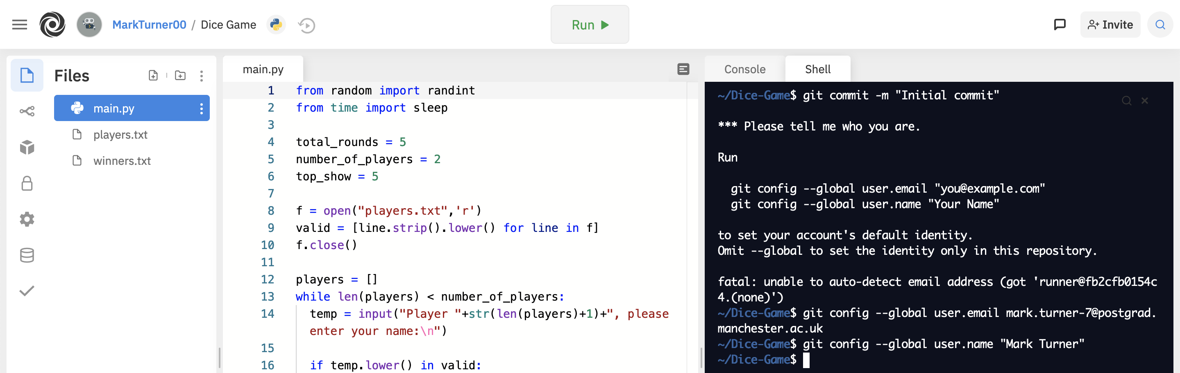
Add your email address and username as per the instructions:

Slide 22
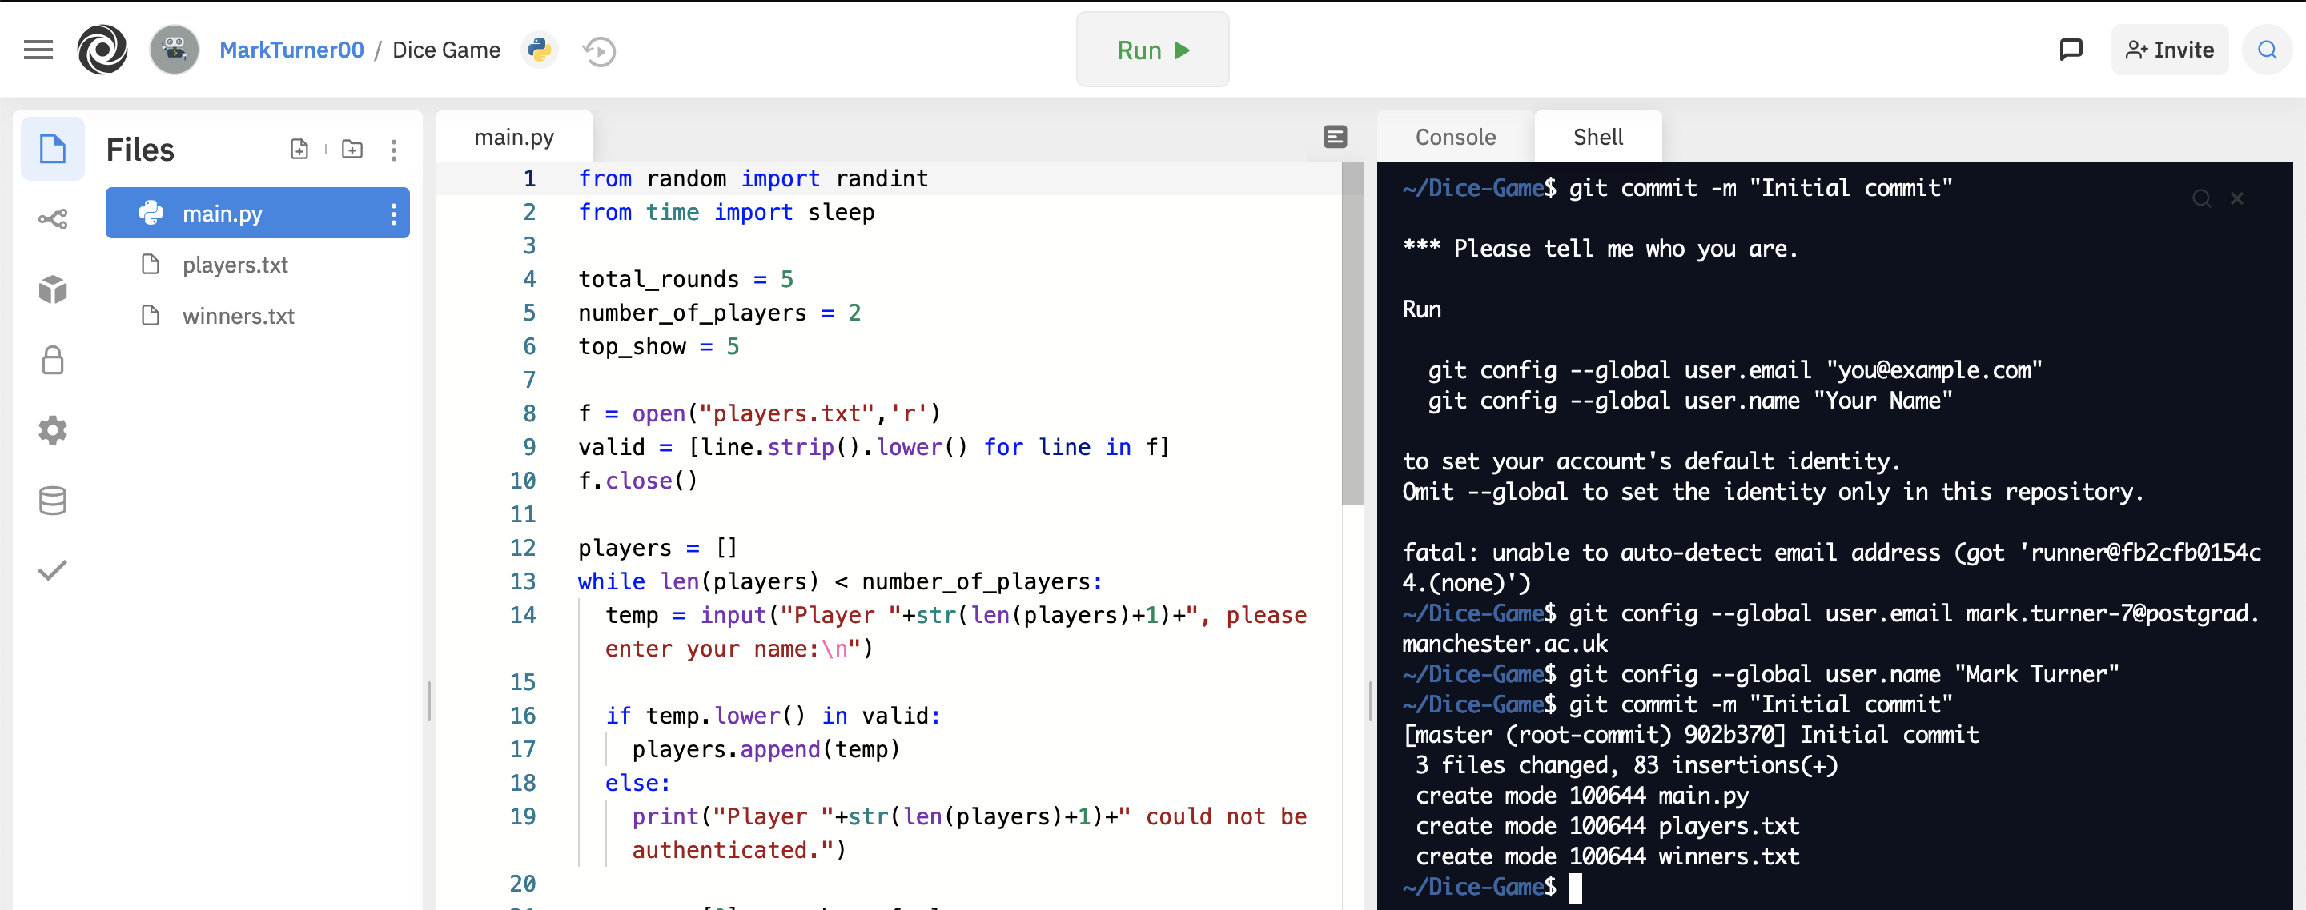
Now it’s time for our first commit! (attempt 2)

Slide 23
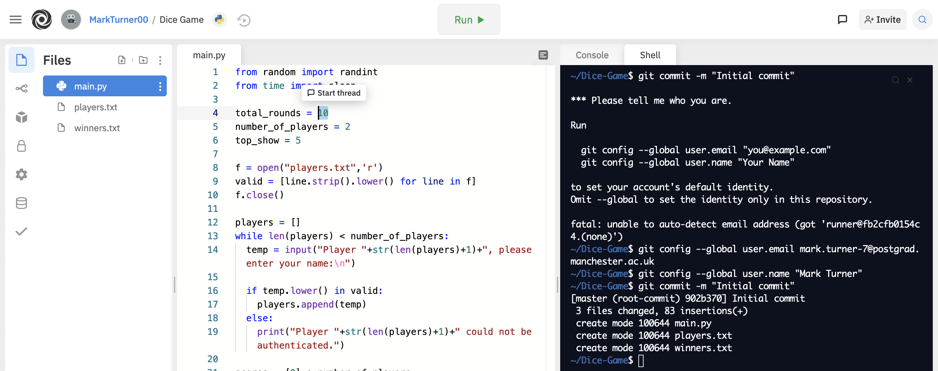
Now let’s modify our code again…

Slide 24
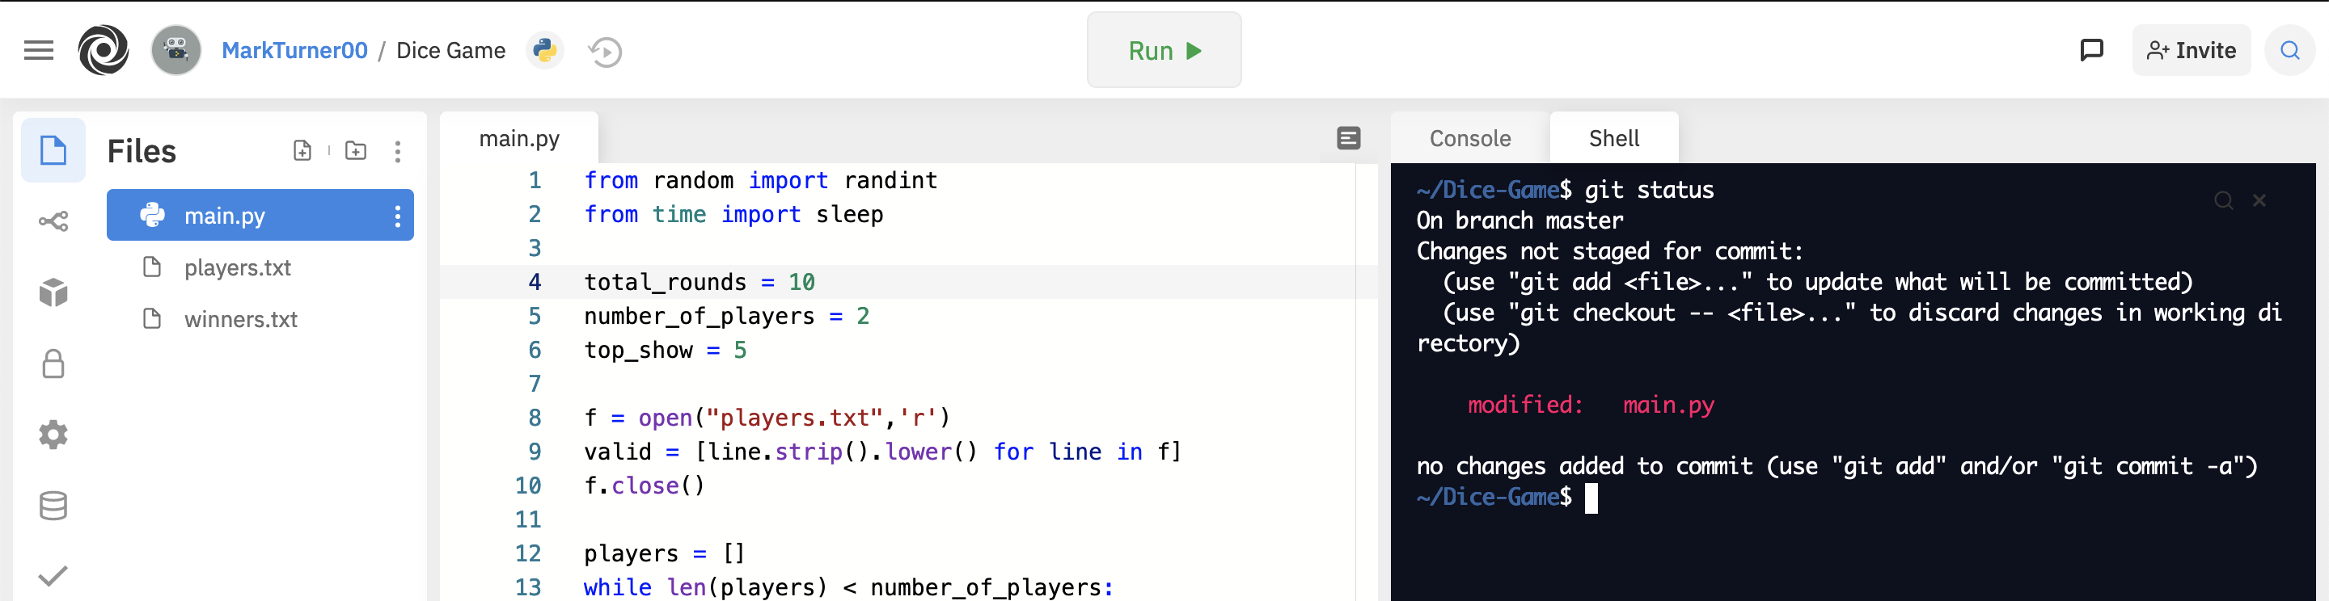
And see what git is doing:

Slide 25
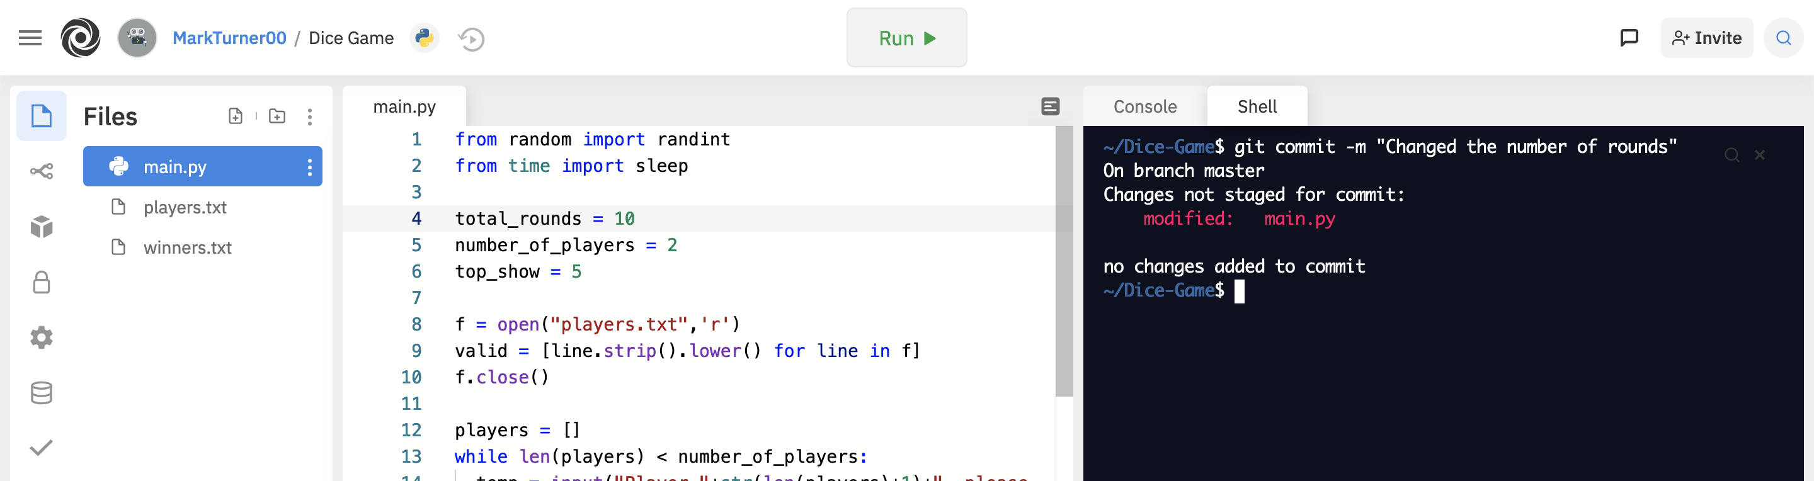
Let’s try and commit…

Slide 26
Commit
Created helpers.py
Deleted temp.txt
Staging Area
Modified main.py
Files on your computer

Slide 27
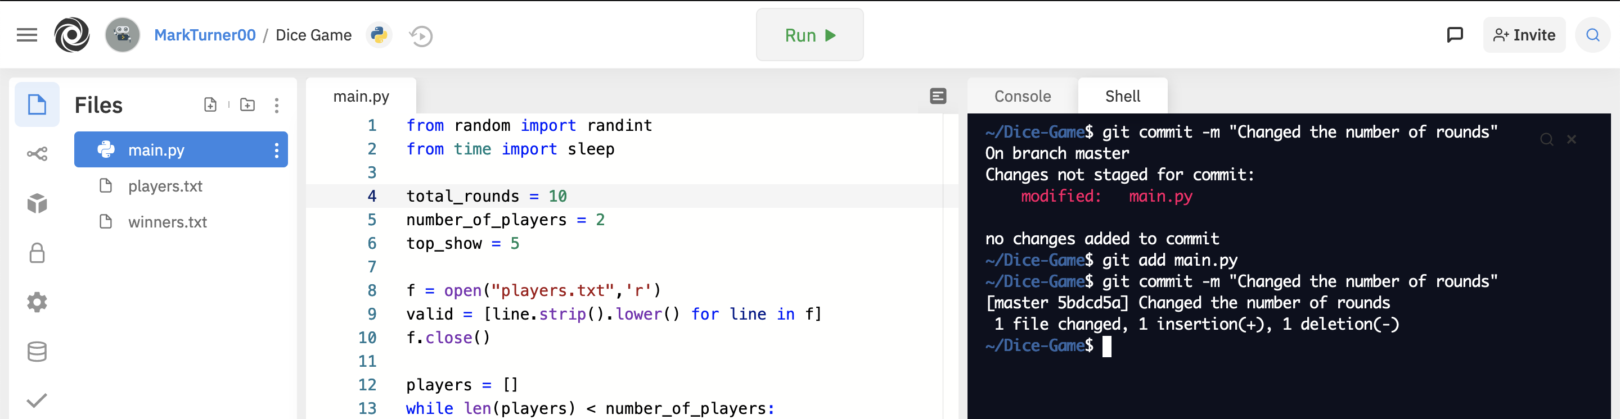
You always need to stage the changes first

Slide 28
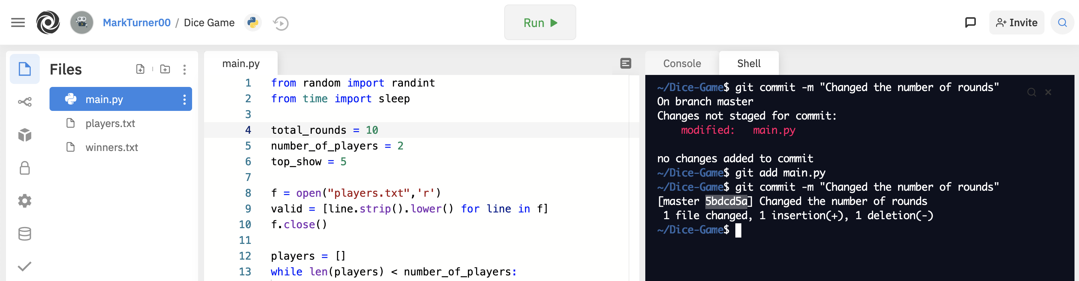
These characters here are your unique commit hash:

Slide 29
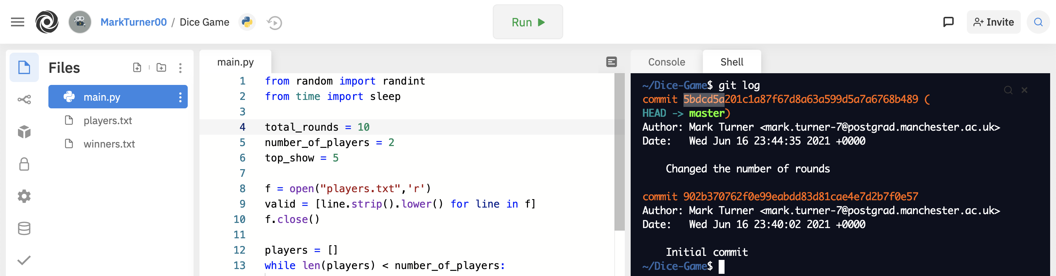
You can view commit history and the commit hashes with “git log”:

Slide 30
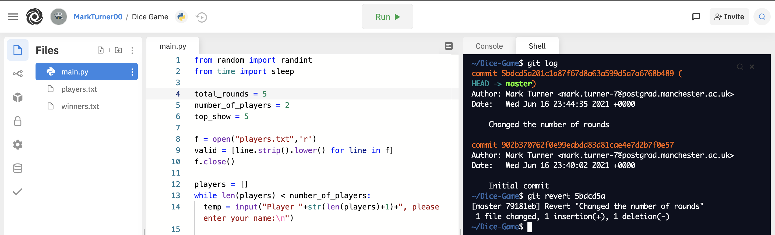
And you can undo a commit with “git revert [hash]”:

Slide 31

Git remote servers
GIT != GITHUB
!=

Slide 32


GitHub
GitLab
BitBucket

Slide 33

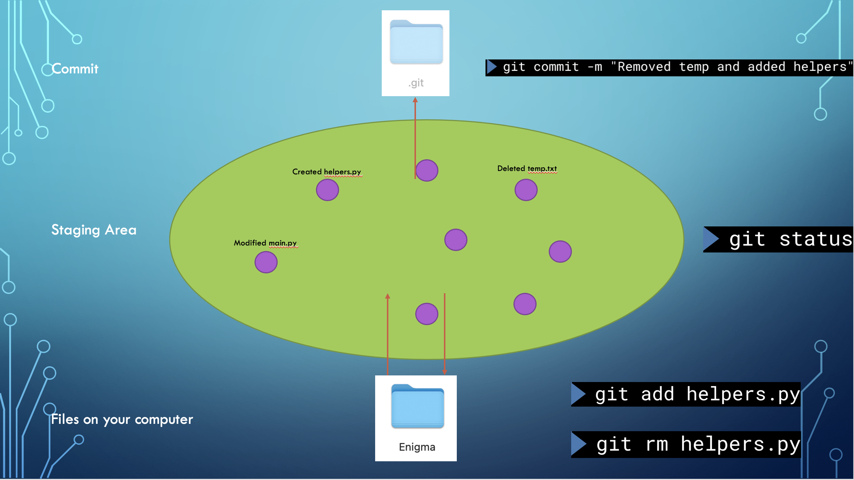

Slide 35
Task: create a github account and push your commit to github!

Slide 36

Go to https://github.com

Slide 37
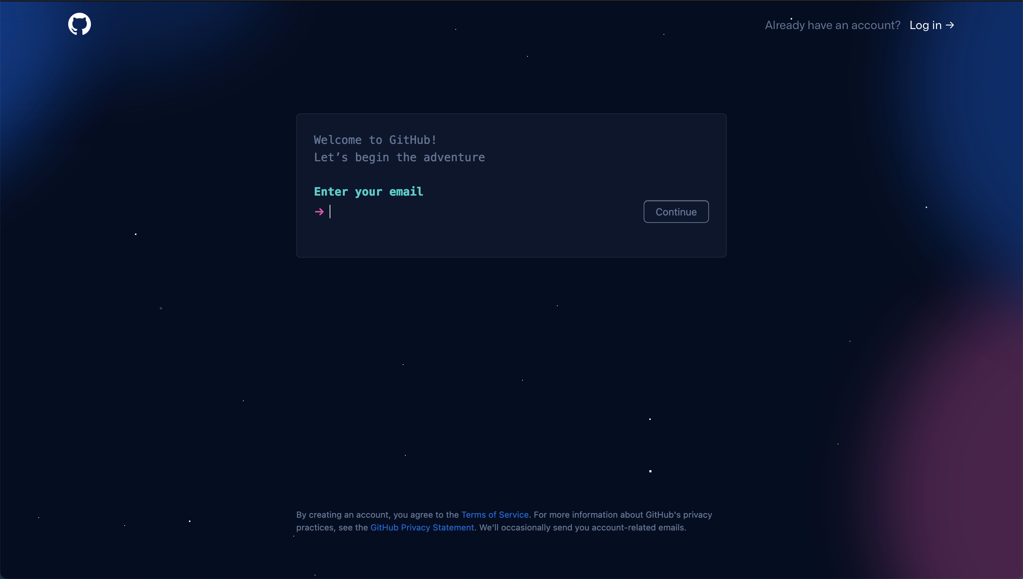
And create your account!

Slide 38
Hit + in the top right corner to create a new repository (place to put your git)

Slide 39
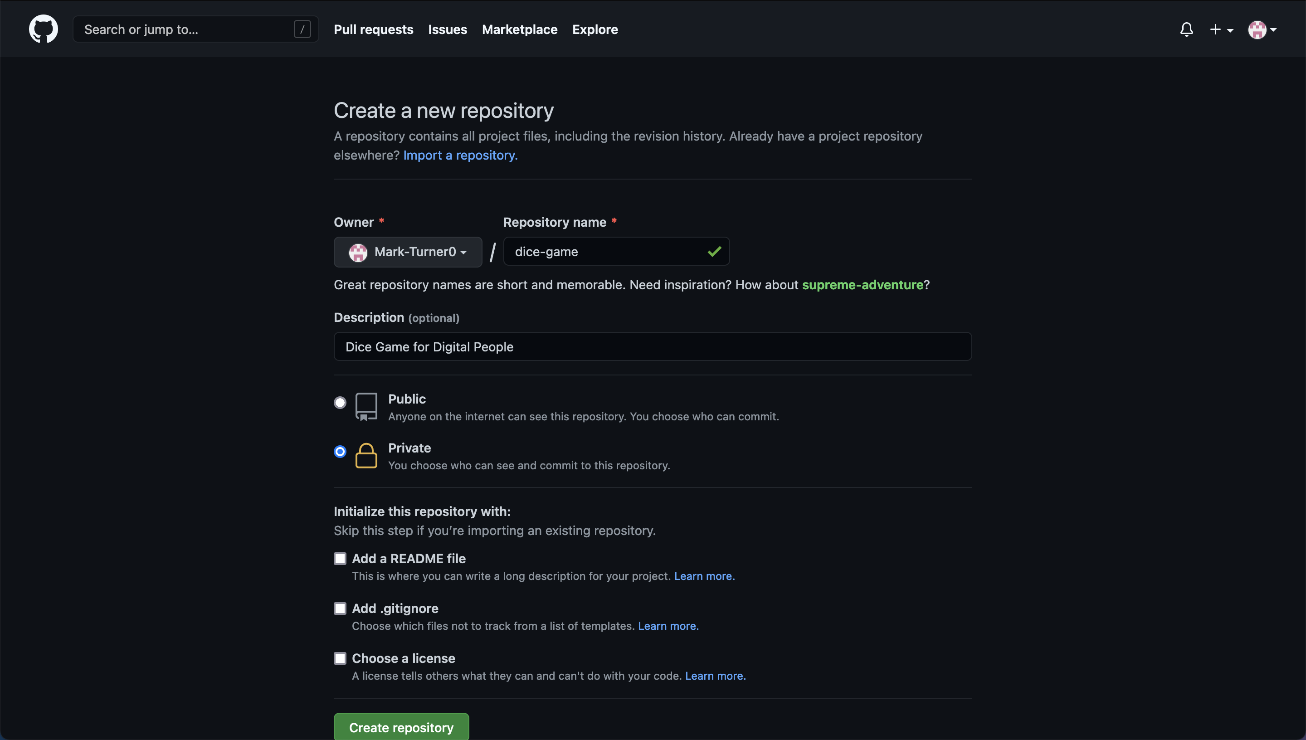
Fill out the details and hit “create repository”:

Slide 40
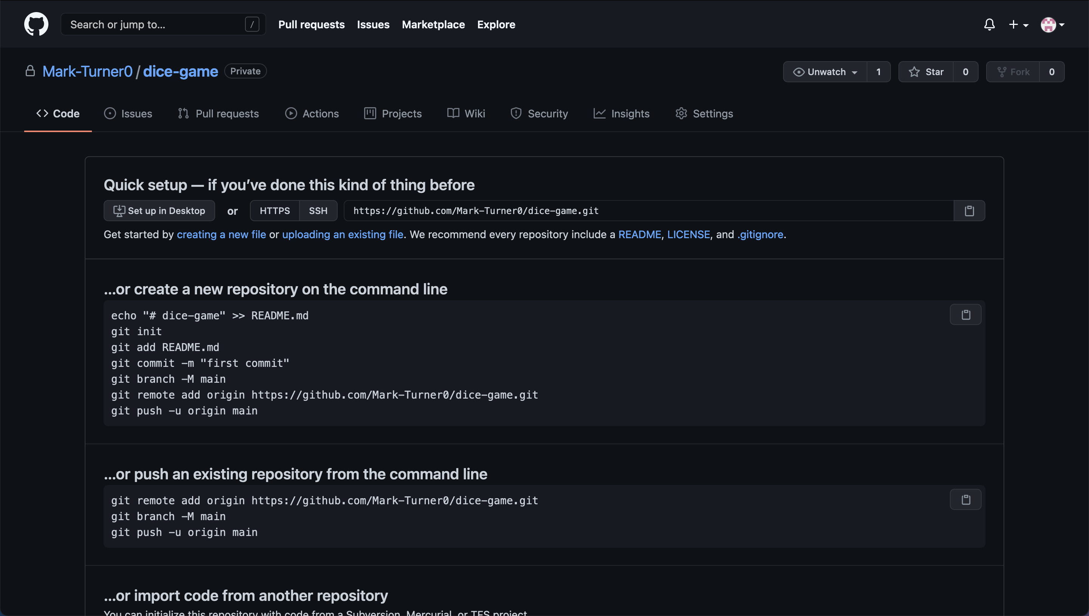
Now we need to tell our command line where this new repository is:

Slide 41
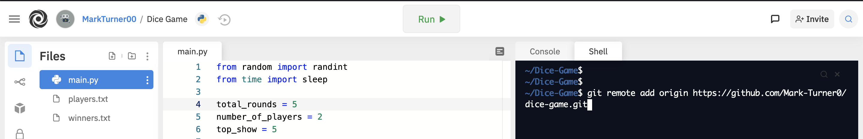
”Git remote add” connects our git to the remote server

Slide 42
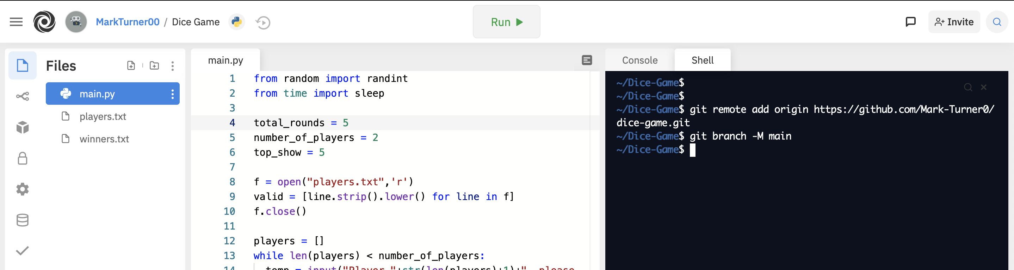
”git branch –m main” you don’t need to worry about for now (renames ”master” to match what github expects)

Slide 43
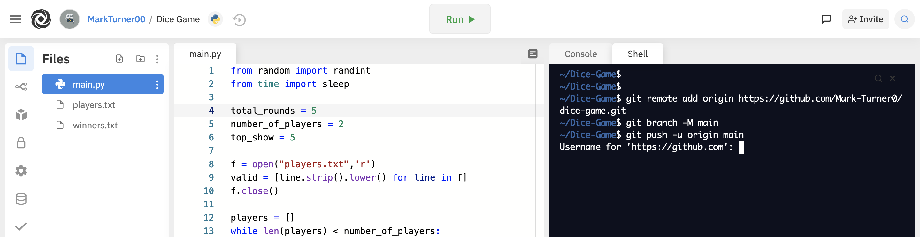
”git push –u origin main” pushes our git to github (it will ask you to log in)

Slide 44
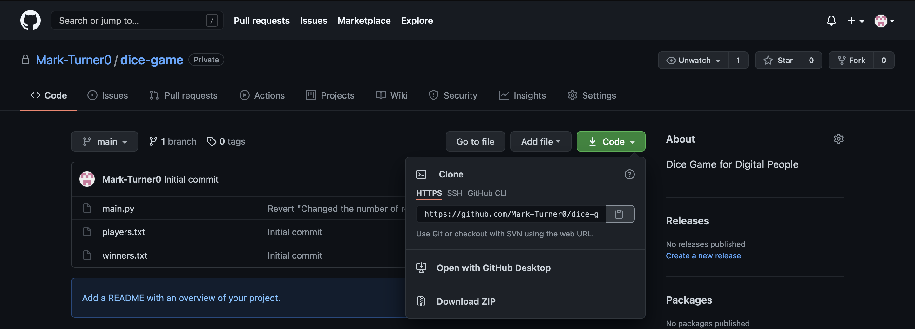
And now to put this on another machine, all we need to do is type “git clone https://github.com...”

Slide 45
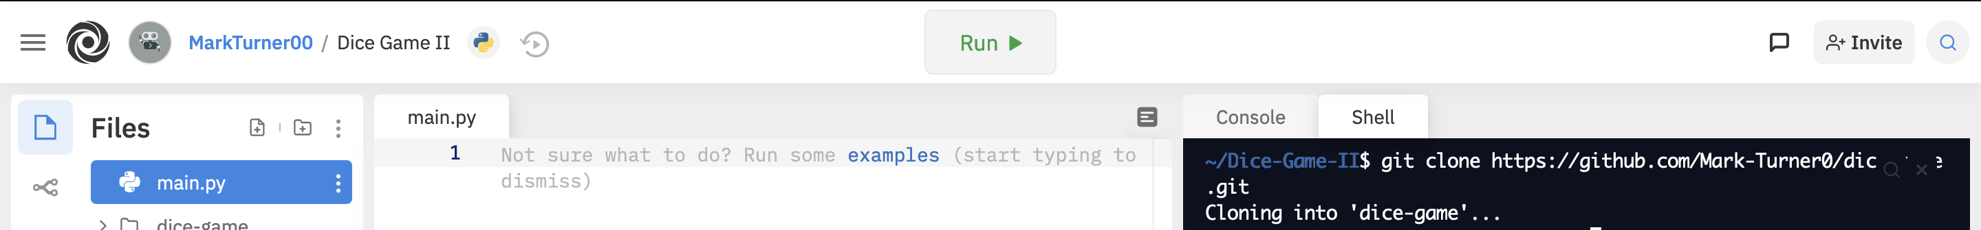
And now to put this on another machine, all we need to do is type “git clone https://github.com...” into the shell

Slide 46
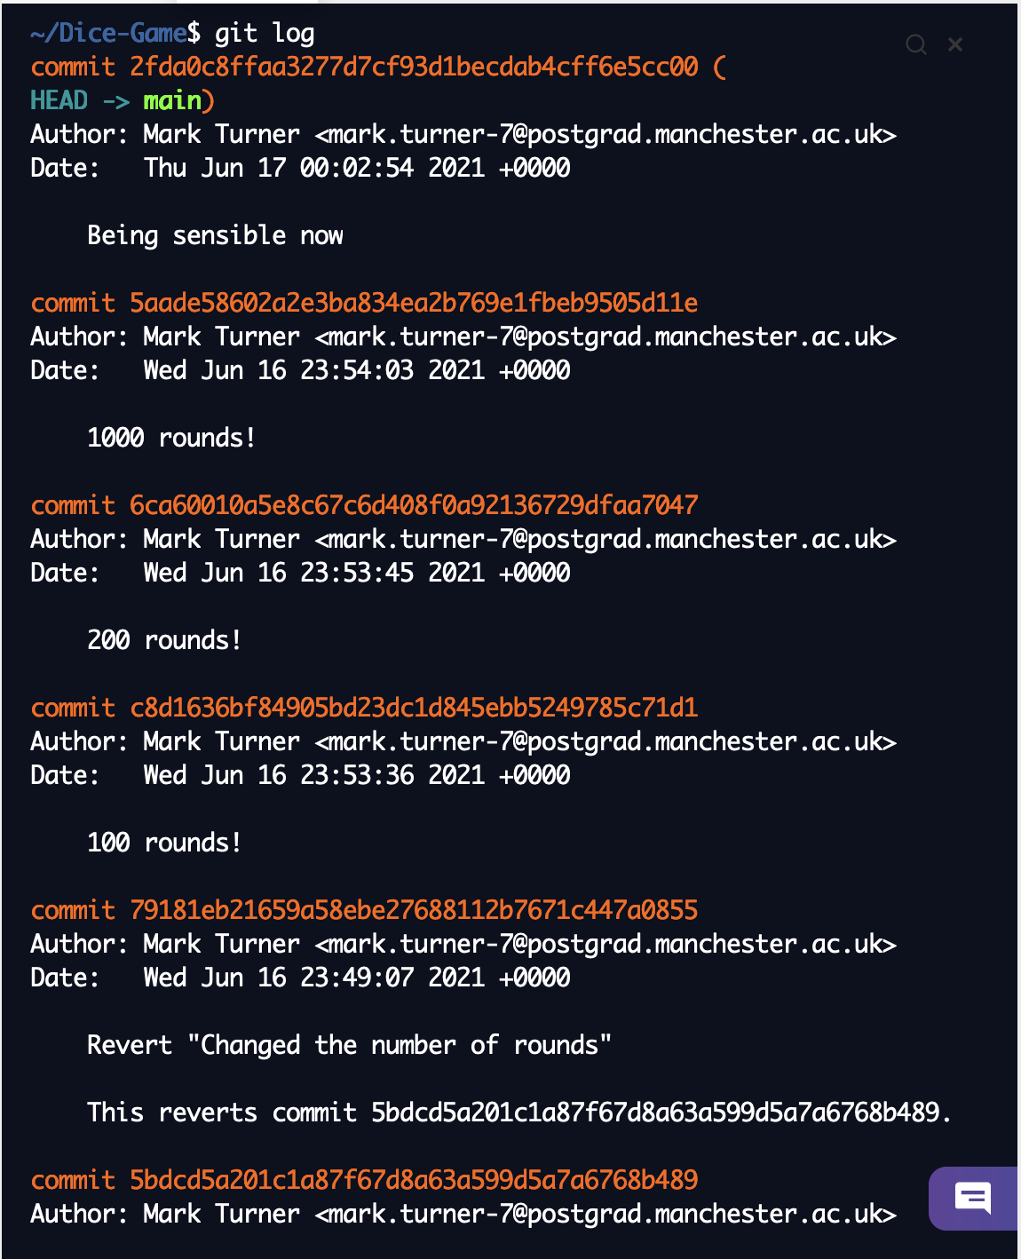
And git will even copy over all the old commits!
To check for new commits that have been pushed to the remote repository, type “git pull”

Slide 47
Final Task: download this presentation with “git clone https://github.com/Mark-Turner0/git-presentation.git”

Slide 48
But there’s so much more you can do with git!

Slide 49
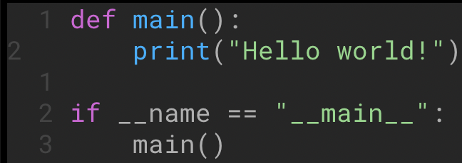
Merging
Of course, when multiple people work on the same file, you can have conflicts:

Slide 50
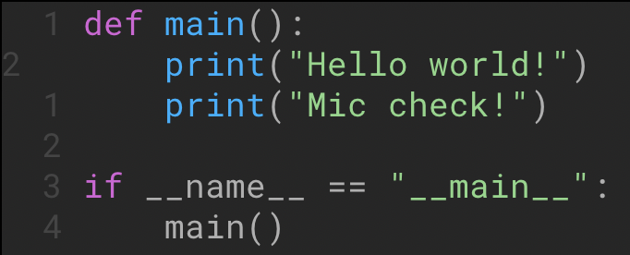
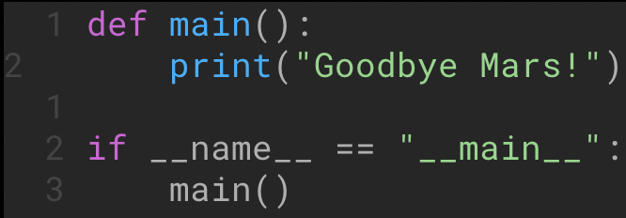
Alice
BOB
X

Slide 51
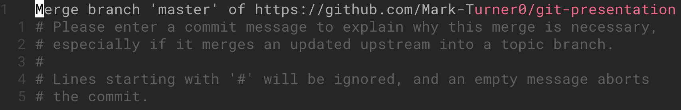
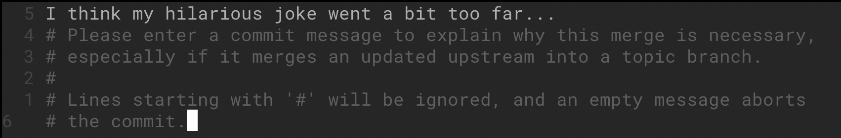
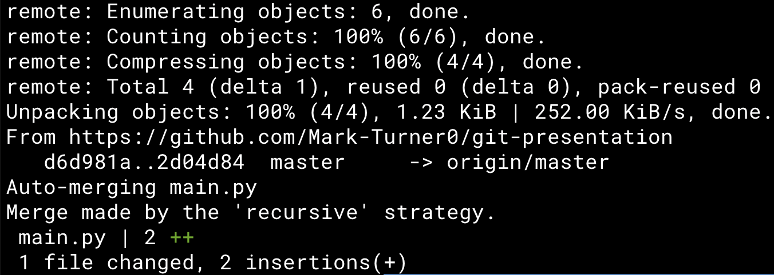

Slide 52
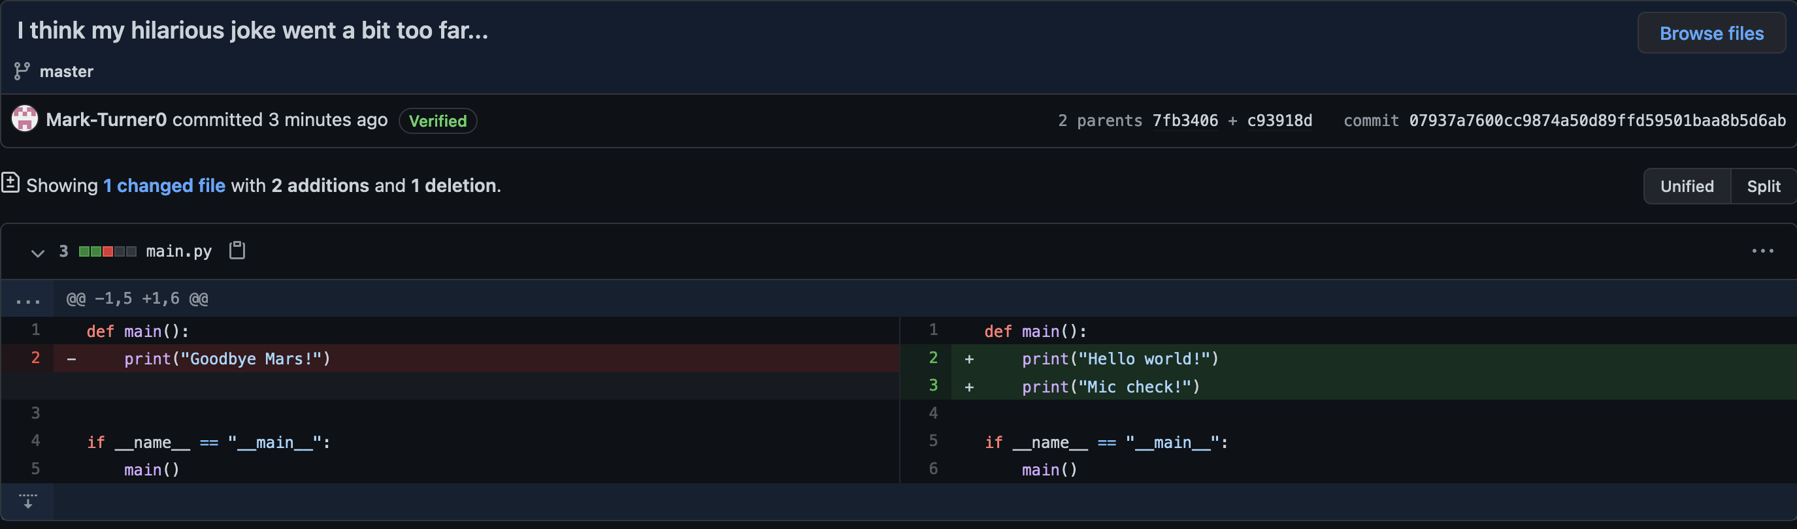
This is not good!

Slide 53
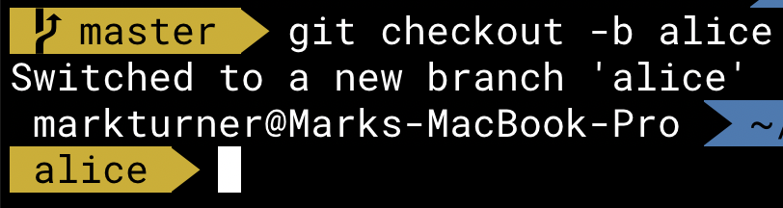
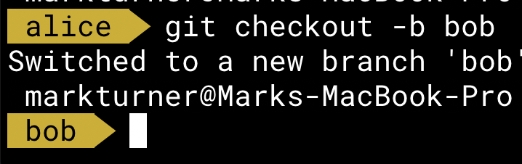
branches
Branches are a good way to separate what you’re working on out from what everyone else is working on
The master / main branch contains the final code, and other branches can be for development or testing

Slide 54
branches
Alice
Pull Request
Master / Main
Pull Request
Bob

Slide 55
Pull requests (PR_{s})
A ”Pull Request” (PR), also known as “Merge request” is a request to “pull” / “merge” the code of one branch or fork into another branch.
As you will see, this is a good way of keeping track of changes, and also ensuring that no conflicts make it into the master / main branch
The owner of the repository can choose to merge the pull request, comment on it, or close it

Slide 56
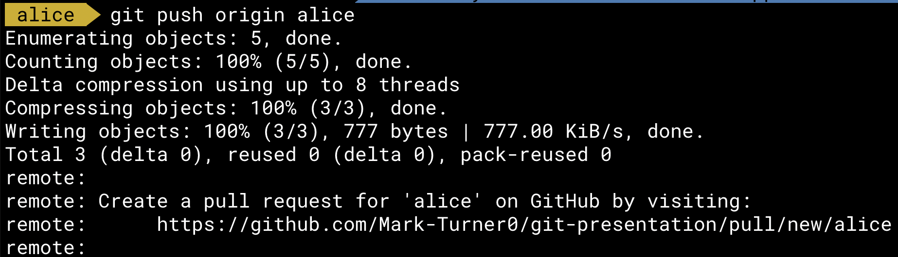
Pull requests (PR_{s})

Slide 57
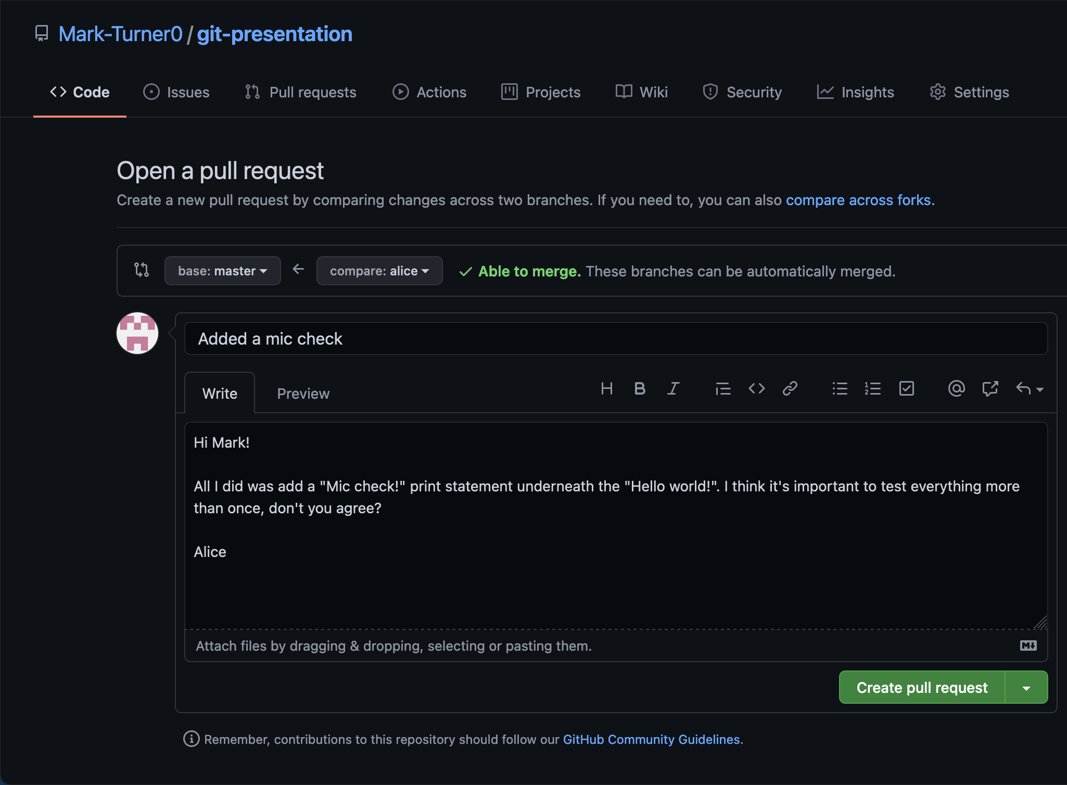
Writing a pull request:

Slide 58
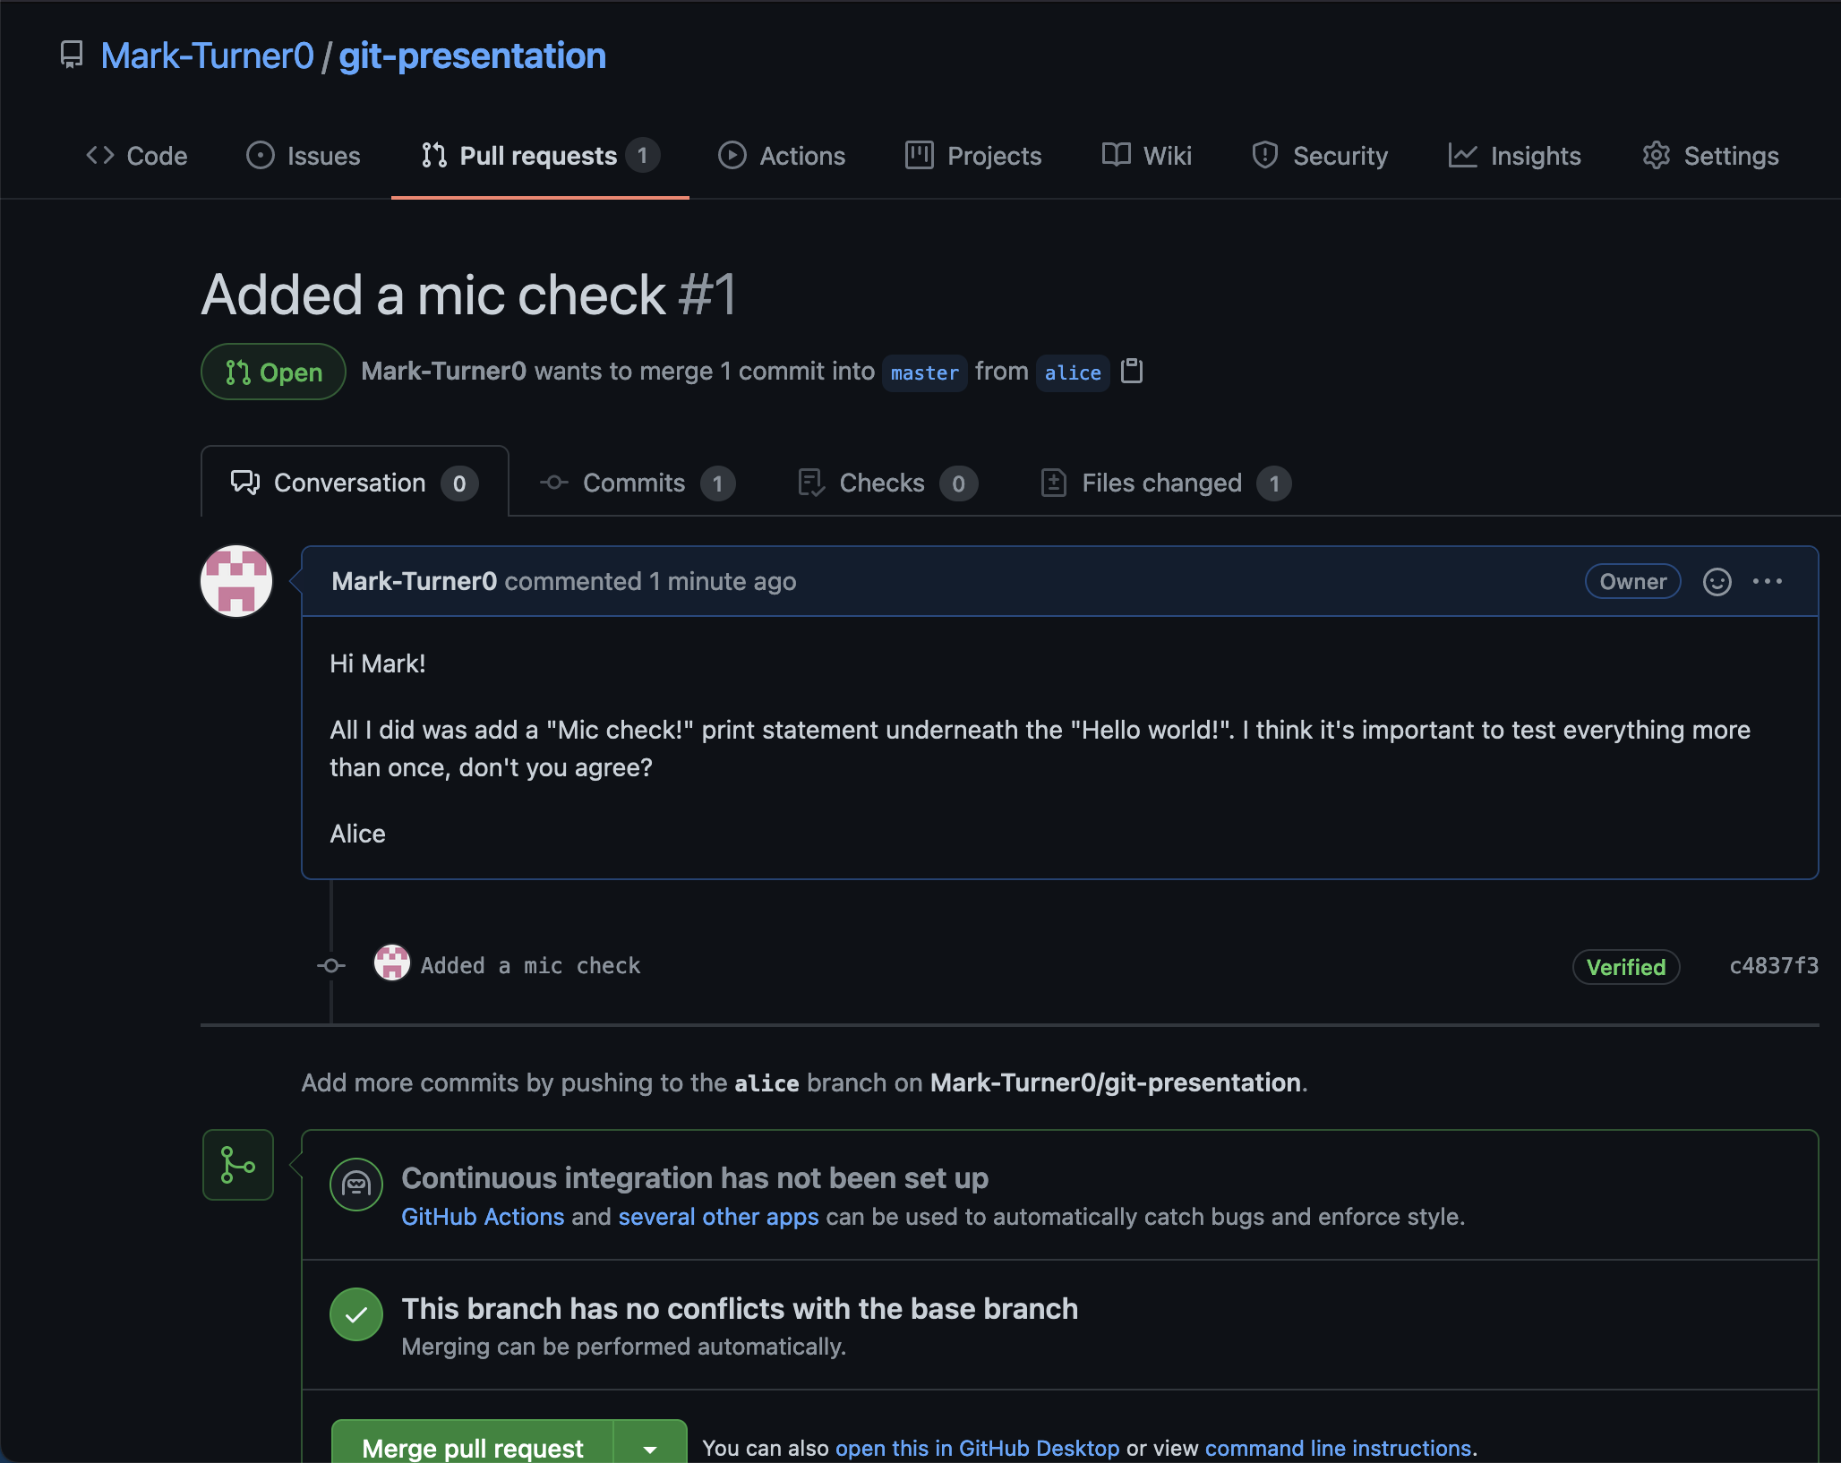
Now I have received it:

Slide 59
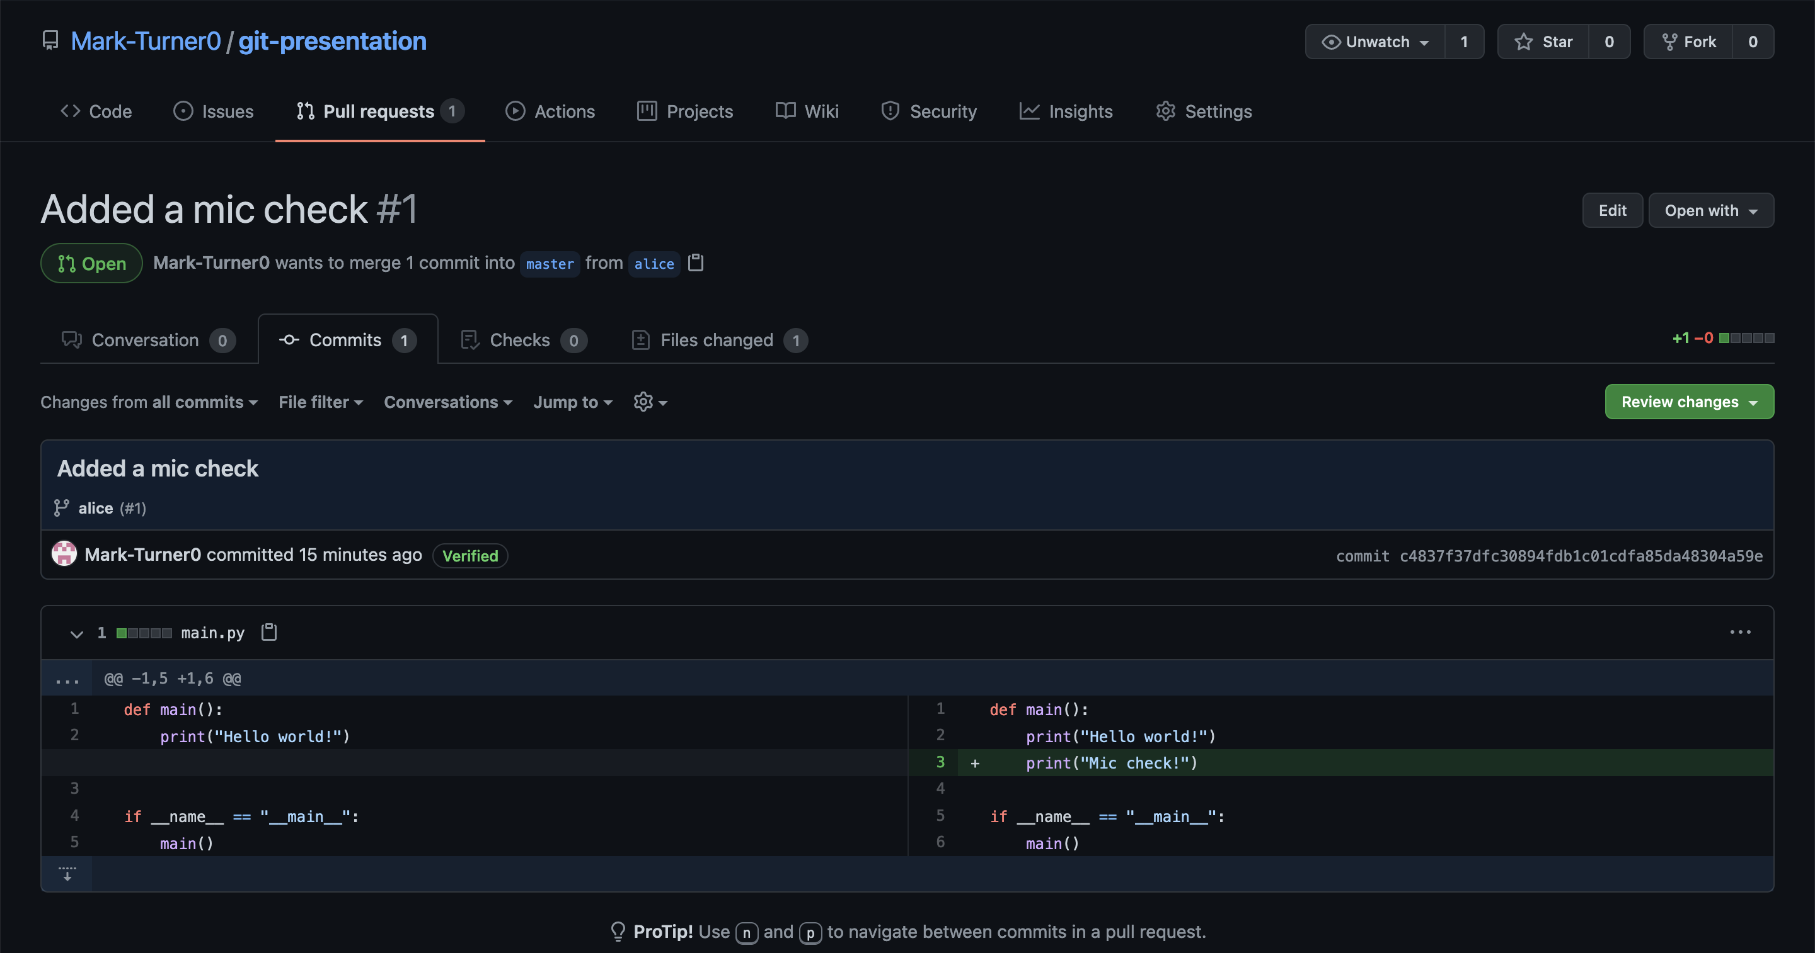
I can review the changes

Slide 60
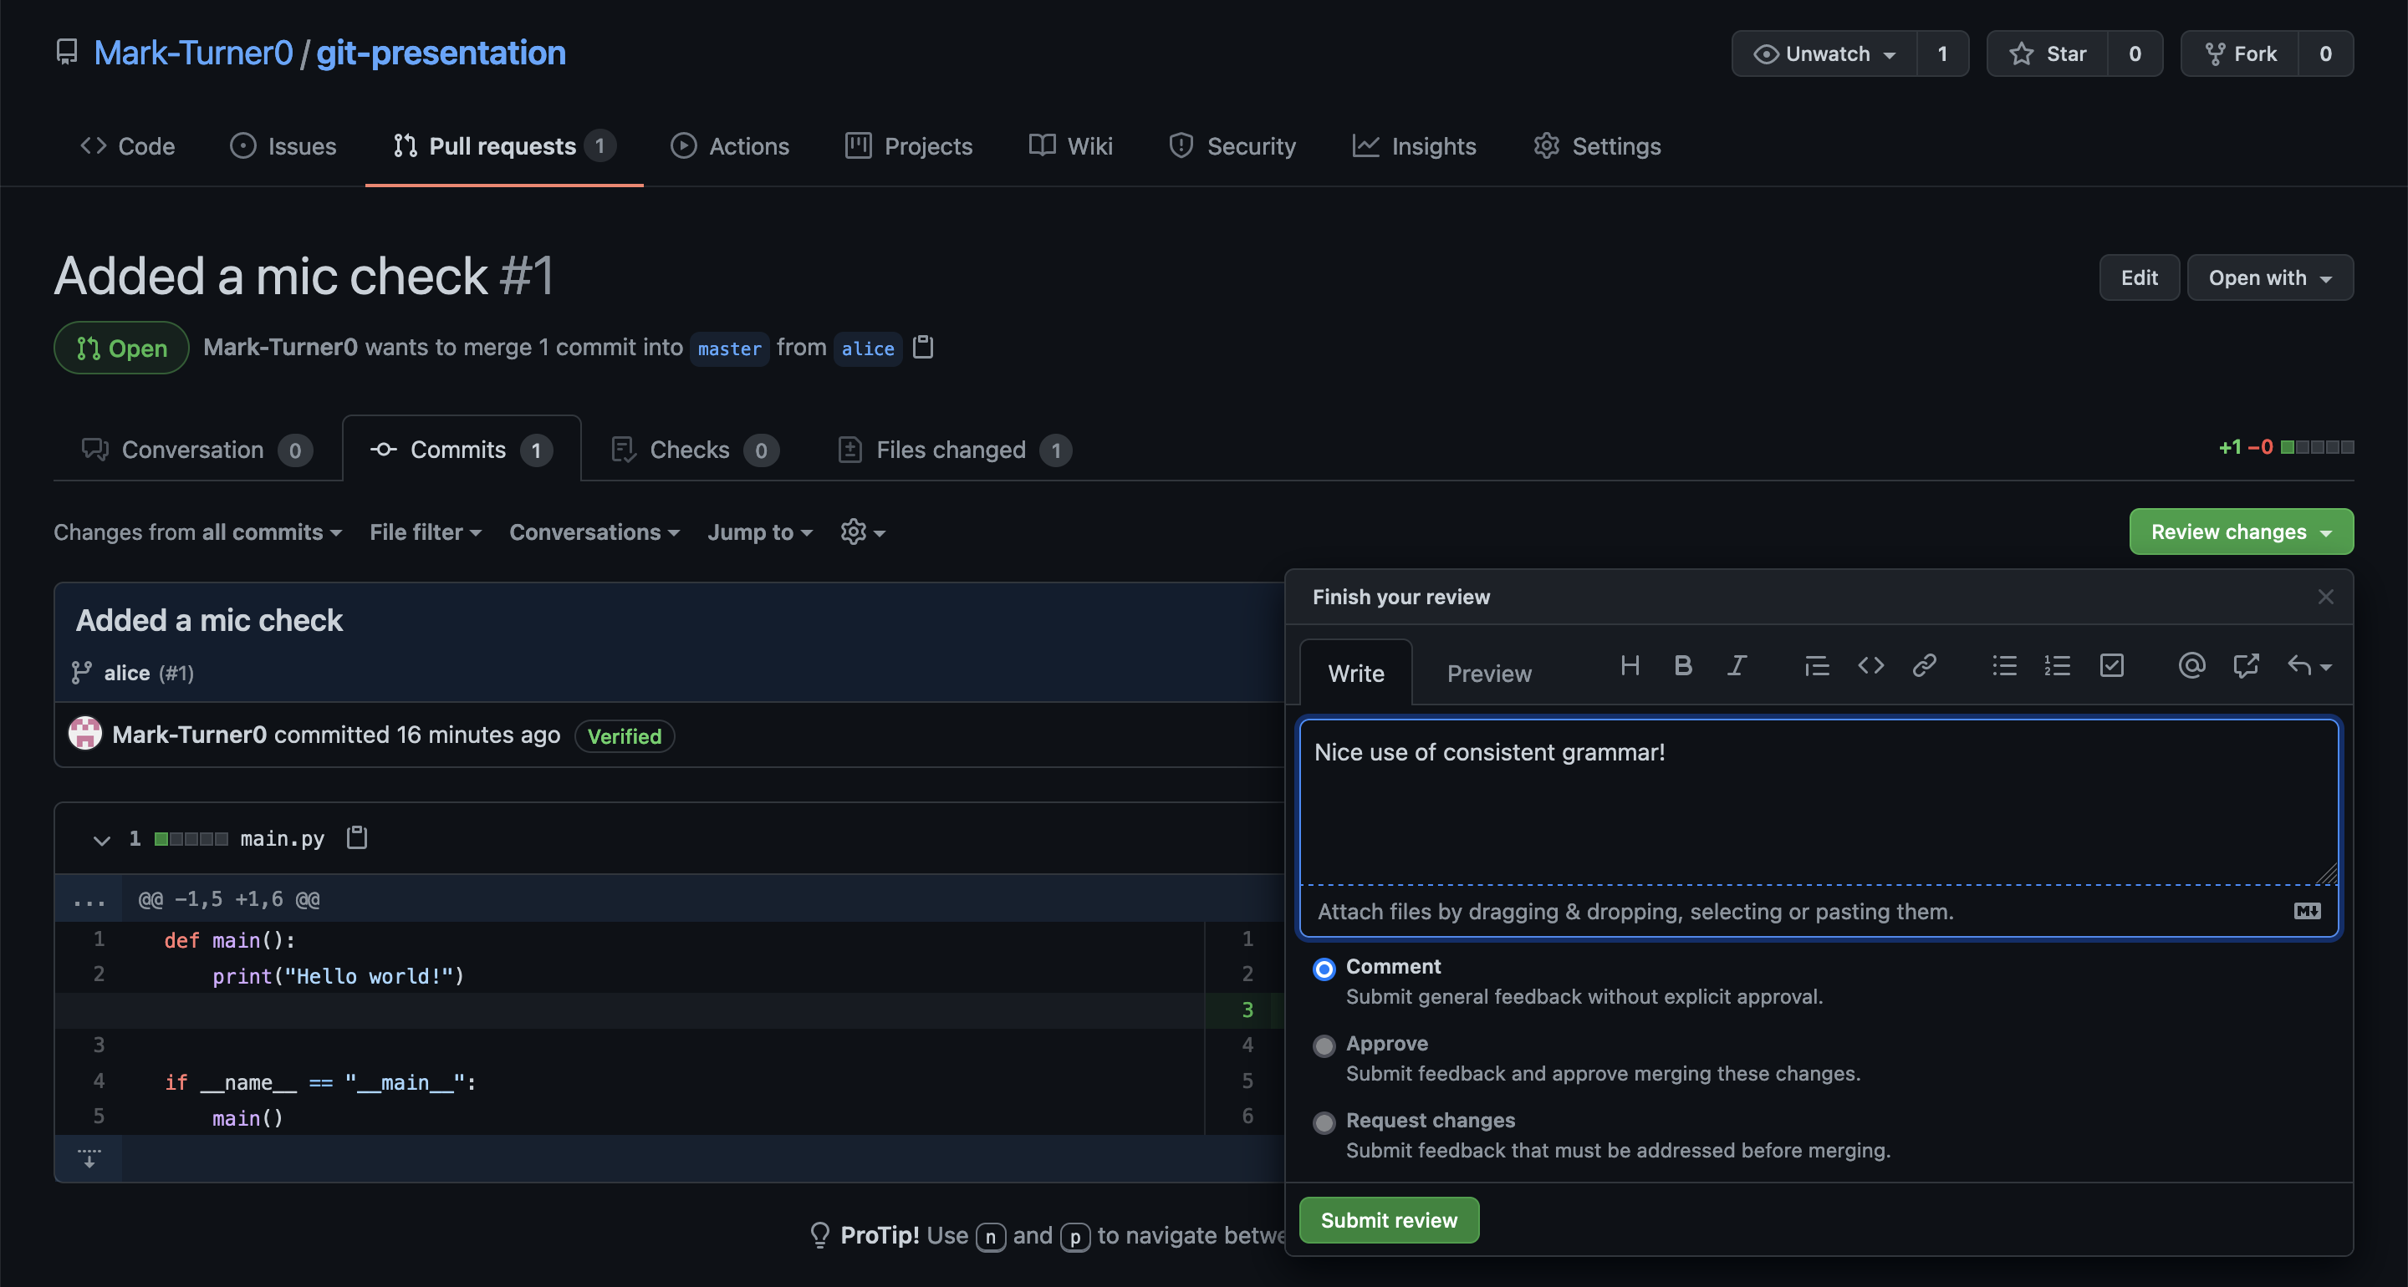
Comment on the changes:

Slide 61
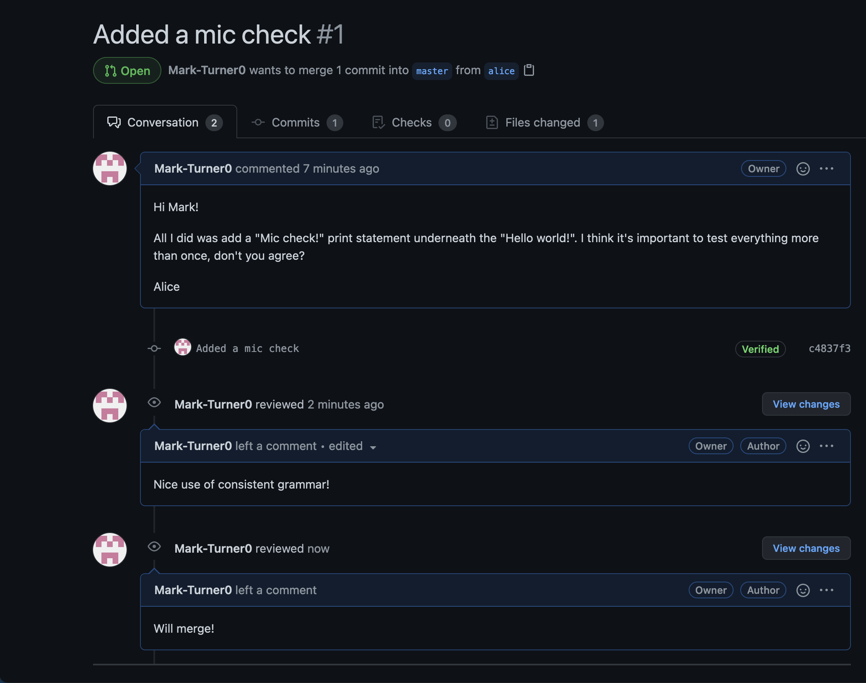
And approve the pull request

Slide 62
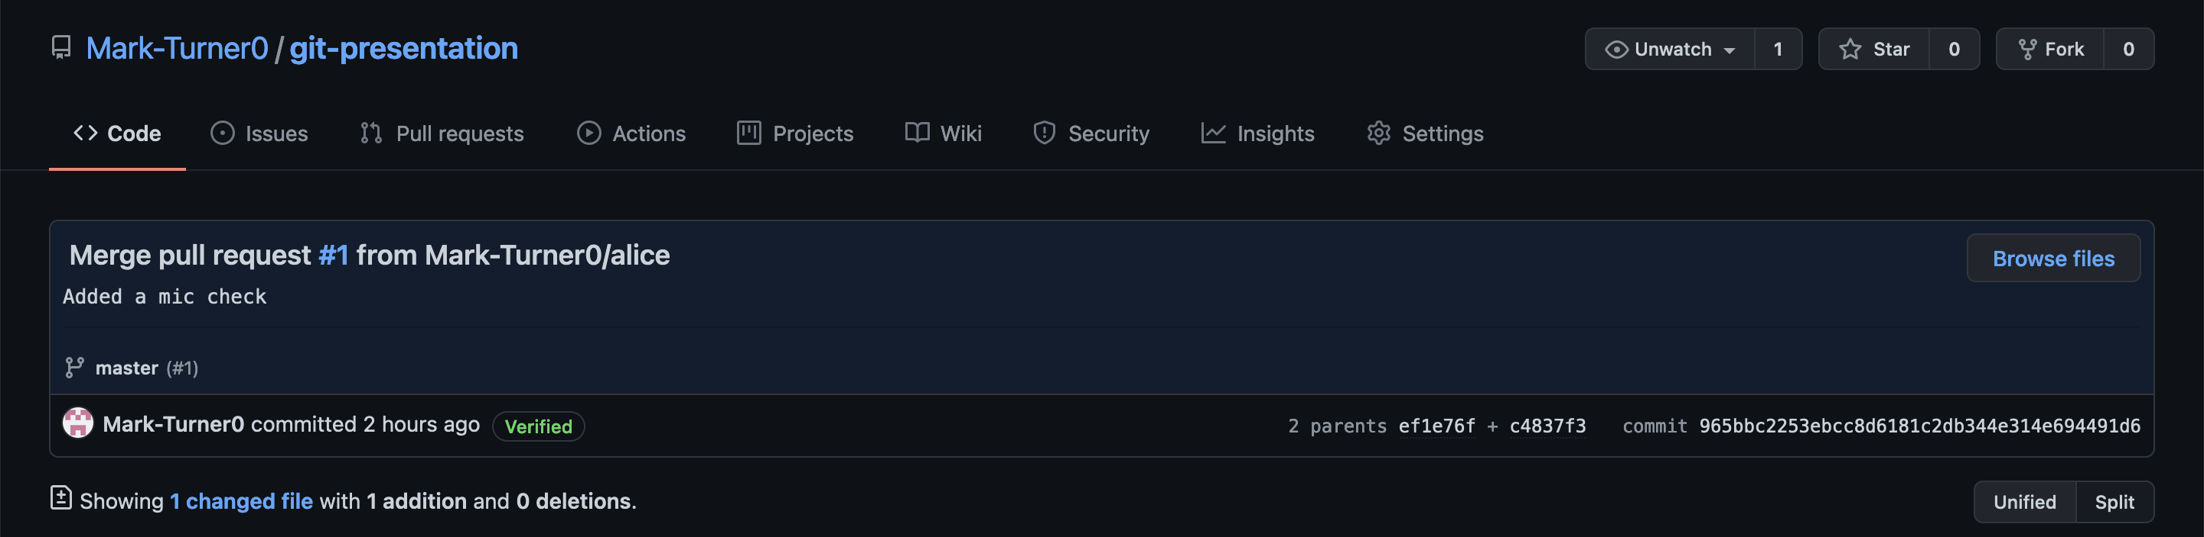
And now it’s been merged!

Slide 63

Another pull request received, but this time with a conflict!

Slide 64

Another pull request received, but this time with a conflict!

Slide 65

I could either tell bob to fix it…

Slide 66

And close the merge request:

Slide 67

Or I could try and fix the conflict myself

Slide 68

Done!

Slide 69

And then approve the pull request!

